Slide 1
Process Improvement Opportunity: Simplifying the Underwriting Process
Target Stakeholder Group: Banks/Underwriters/Firms

Slide 2
The Problem

Slide 3
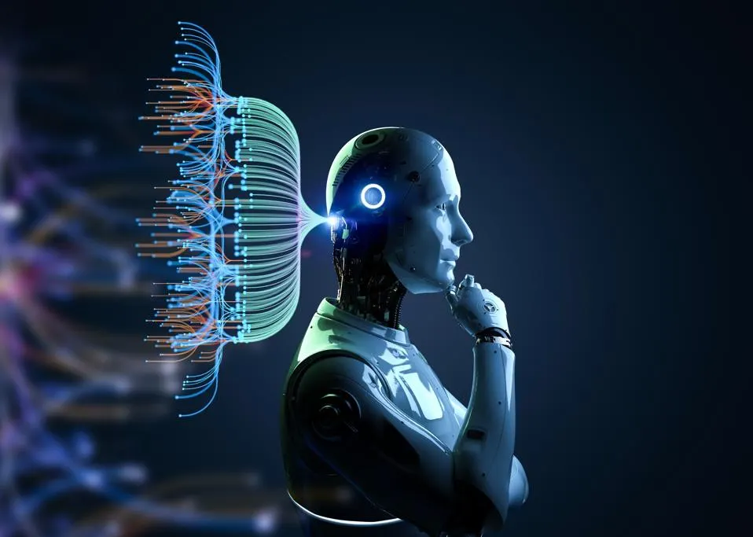
Problem
The Underwriting Process is very time consuming and slow. It needs to be automated
There needs to be systems in place to facilitate the new process, such as AI

Slide 4
Solutions

Slide 5

Solution 1: Use AI to fix the manual review of loan documents
Using AI models and having human verifiers would save lots of time while also ensuring accuracy for seeing if someone is approved for a loan.
The AI model would preferably look through piles of loan data and do manual calculations to qualify someone for a specific loan. The human verifier would also look through this same data as well as see if the credit score and LTV ratios that the potential borrower has match up with the AI’s figure.
Pros
Cons
Faster
AI Uncertainty
Streamlined
Unclear Risk Avoidance
Increased Accuracy

Slide 6

Solution 2: Heavier emphasis on data analytics and science
Creating analytics either by hand or through AI would help make decisions a lot easier and more educated.
Training the AI and/or analytics platform to perform routine tasks automatically could significantly reduce costs and time.
Pros
Cons
Consistent
Limited Adaptability
Cost Effective
Uncertain how AI handles data quality issues
Accuracy

Slide 7
Summary
AI can be very helpful in the future of the underwriting process.
There can be issues initially with implementation and with uncertainties on how current AI handles new data. This is because AI does well with existing, repetitive information.
There are still nonetheless more pros than cons in implementing AI in either a more traditional approach or a more analytical approach. Either one is something many companies will be looking into anyways.

